Slide 1
WHAT IS 8 QUEEN PROBLEM?
The eight queens puzzle is the problem of placing eight chess queens on an 8 8 chessboard so that no two queens attack each other.
Thus, a solution requires that no two queens share the same row, column, or diagonal.
The eight queens puzzle is an example of the more
general n-queens problem of placing n queens on
an n n chessboard, where solutions exist for all natural numbers n with the exception of 1, 2 and 3.
The solution possibilities are discovered only up to 23 queen.

Slide 2
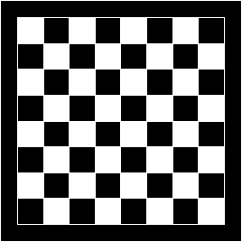

Formulation :
States: any arrangement of 0 to 8 queens on the board
Initial state: 0 queens on the board
Successor function: add a queen in any square Goal test: 8 queens on the board, none attacked

Slide 3
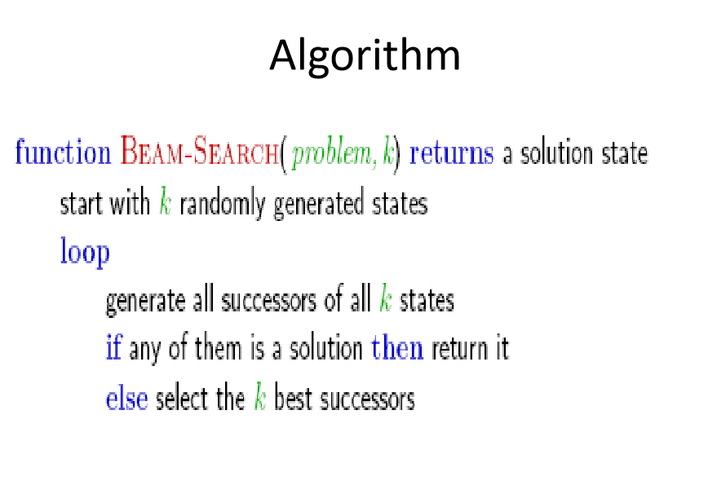
Local Beam Search
Beam search explores more than one path together.
If k=2, then two branches are explored at a time. For k=4, four branches are explored simultaneously.
The branches selected are the best branches based on the used heuristic evaluation function
A factor k is used to determine the number of branches explored at a time.

